Slide 1
Create Your Own State

Slide 2
What would the name of the State be?
Meaning
Ohio - The state takes its name from the Ohio River, whose name in turn originated from the Seneca word ohiːyo', meaning "good river", "great river" or "large creek".
Florida - The name "Florida" comes from the Spanish word "florido," which means "full of flowers," or "flowery."

Slide 3
Where would your state be located?
You need to figure out where you would want your state located.
Cut out from another state?
Located in another country?
An island?
Needs to be a nonfictional place

Slide 4
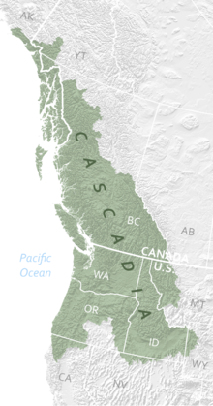
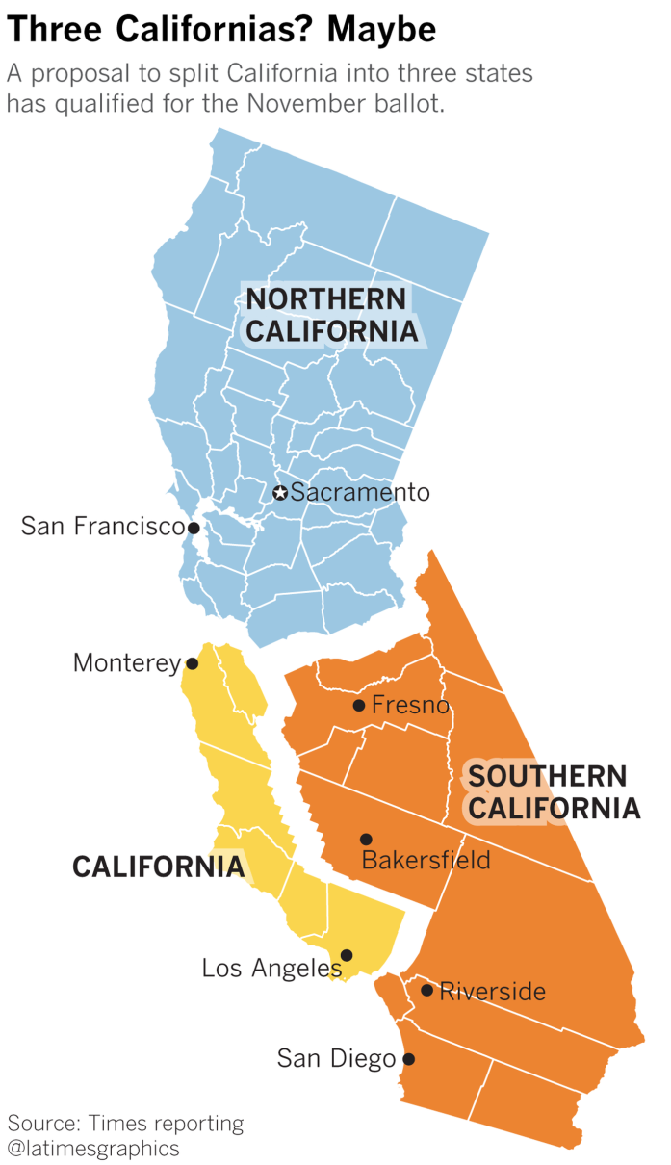
Cascadia
California Divided

Slide 5
Your Flag
Design a flag for your state
Need to explain what everything means
Colors
Images

Slide 6
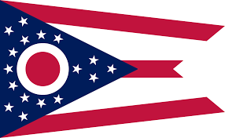
The flag of the state shall be burgee-shaped. It shall have three red and two white horizontal stripes that represent the roads and waterways of the state. The union of the flag shall be seventeen five-pointed stars, white in a blue triangular field that represents the state's hills and valleys, the base of which shall be the staff end or vertical edge of the flag, and the apex of which shall be the center of the middle red stripe. The stars shall be grouped around a red disc superimposed upon a white circular "O." The thirteen stars grouped around the "O" represent the original states of the United States and the four stars added to the peak of the triangle symbolize that Ohio was the seventeenth state admitted to the union. The "O" represents the "O" in "Ohio" and suggests the state's nickname, the buckeye state. The proportional dimensions of the flag and of its various parts shall be according to the official design on file in the office of the secretary of state.

Slide 7
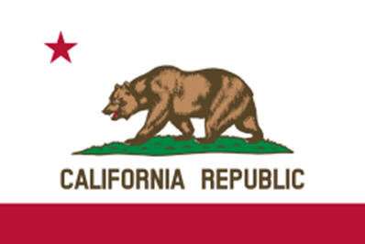
The once common California grizzly bear (also the official state animal) portrays strength; the star represents sovereignty; the red color signifies courage; and the white background stands for purity.

Slide 8
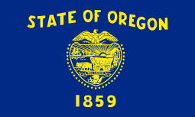

Slide 9
NEED:
State Name & Meaning
State Location
State Flag & Meaning

