Slide 1
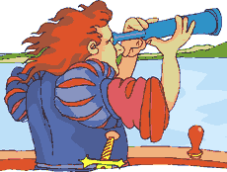
Europeans Set Sail

Slide 2
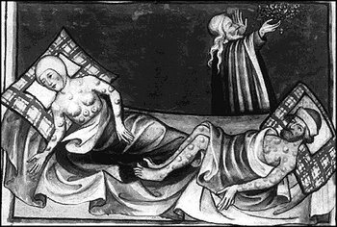
I. European Economy Grows
A. In the mid-1300’s, Italian merchants returned from Asia carrying rats infected with bubonic plague.
B. The Black Plague, also known as the Black Death, swept through Europe from 1348 to 1350 killing 1/3 of Europe’s population.

Slide 3
C. In the 1200’s, Europe began to experience the Commercial Revolution.
1. Period of economic development that began in the 1200’s and greatly expanded trade.
2. Merchants and craftspeople become more aggressive about making a profit.

Slide 4
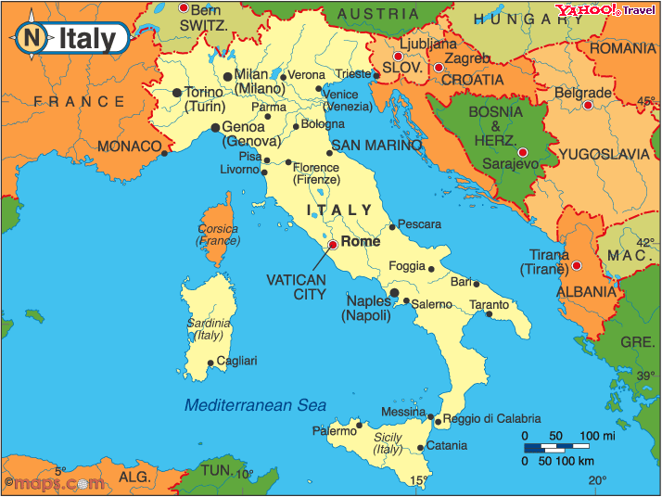
3. Cities often grew rich and specialized in certain crafts.
a. Florence - dyed cloth
b. Venice - glassmaking
c. Italian merchants also began trading for far away goods.

Slide 5
D. Merchant families in Europe wanted to get capital, money or property that is used to earn more money.
1. Banks loaned money and borrowers repaid with interest.

Slide 6
E. Merchants also created joint-stock companies. These are businesses in which a group of people invest together.
1. Investors then share in the companies’ profits and losses.
2. Forming joint-stock companies helped merchants raise money while reducing the risk of starting a business for each investor.

Slide 7
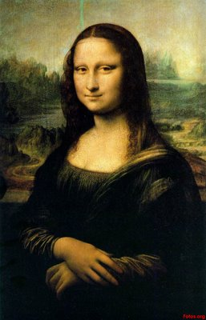
II. The Renaissance
A. Some Europeans used their new wealth to support education and the arts.
B. This helped start the Renaissance, a rebirth of the arts and learning of ancient Greece and Rome. It began in Italy in the 1300’s, and spread across Europe. It lasted into the 1600’s.

Slide 8
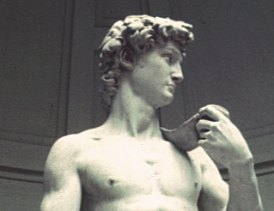
C. Interest in ancient Greek and Roman works mixed with new ideas about art, society, science

Slide 9
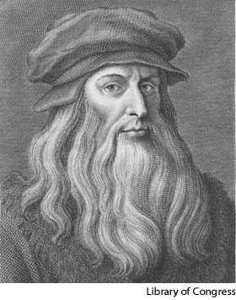
D. Leonardo da Vinci painted the Mona Lisa, and invented many things, including things that wouldn’t be used for centuries.

Slide 10
E. Michelangelo carved David and painted the Sistine Chapel at the Vatican in Rome.

Slide 11
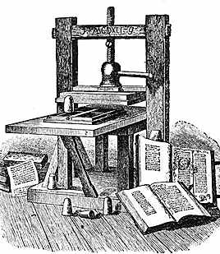
F. Johannes Gutenberg in the 1440’s invented the printing press.
1. Spread the science and literature of the Renaissance across Europe.
2. Allowed a large amount of books to be printed at low costs.

Slide 12
G. Many people believed that human beings were superior to all living creatures. Some people believed that humans could achieve anything. (HUMANISM)
1. Encouraged Europeans to explore the rest of the world.

