Slide 1
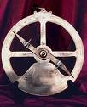
H. The astrolabe and other technological innovations also led to exploration.
1. The astrolabe allowed navigators to learn their ship’s location by charting the position of the stars.
2. Better charts and instruments let sailors travel the sea without needing landmarks to guide them.

Slide 2
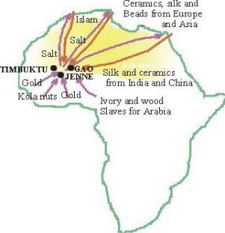
III. Trade With Africa and Asia
A. Much of the wealth of the Commercial Revolution was created through trade.
1. Africa - gold, salt, ivory, and slaves.
2. Asia - silk and spices.

Slide 3
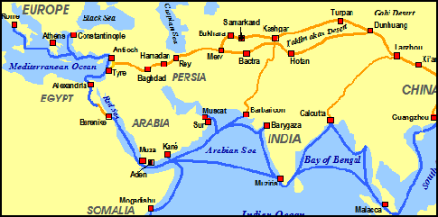
B. Goods usually traveled long overland routes to reach Europe.
1. The Silk Road - stretched several thousand miles westward from China.
2. Journeys were dangerous because of attacks from bandits.
a. Along the way, each merchant raised the price, so it was very expensive when it reached Europe.

Slide 4
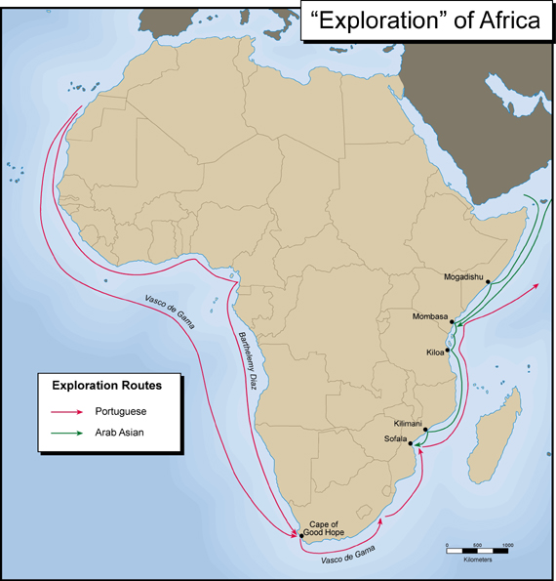
C. Some countries in western Europe wanted to find a new sea route to Africa and Asia. English, French, Portuguese, and Spanish merchants had many reasons for wanting such a route.

Slide 5
1. Did not want to depend on others for goods they needed.
a. Merchants in Venice had a monopoly on Asian products.
b. Monopoly - sole economic control of a business or product.

Slide 6
2. Overland routes had become less reliable and bandit raids increased.
3. Ship designs improved.
4. Increase in Europeans wanting to know more about Asia and Africa.

Slide 7
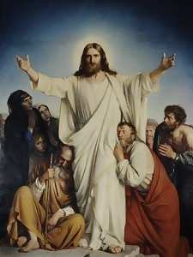
5. Europeans hoped to spread Christianity.

Slide 8
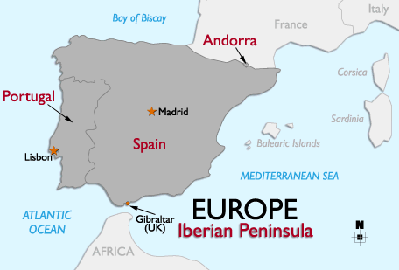
IV. The Portuguese Explore Africa
A. Portugal became one of the early leaders in exploration in the early 1400’s.

Slide 9
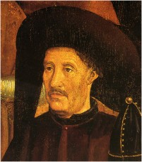
B. Prince Henry the Navigator, greatly aided Portugal’s efforts.
1. Prince Henry the Navigator gathered together the finest mapmakers, sailors, and shipbuilders, in the town of Sagres.
2. Prince Henry helped improve navigation instruments such as the compass.

Slide 10
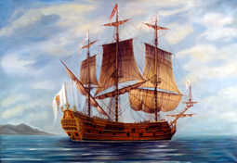
3. Developed the caravel, a fast, maneuverable ship that could sail against the wind.
4. Paid for exploring the coast of Africa.

Slide 11
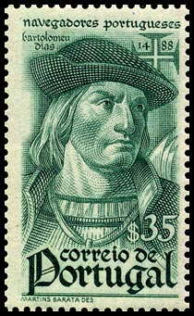
C. Bartolomeu Dias, a Portuguese navigator, led an expedition along the African coast.
1. Got caught in a storm, and blew around the southern tip of Africa. This point became known as the Cape of Good Hope.
2. First European to sail around this tip and into the Indian Ocean.

Slide 12
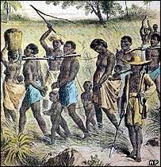
D. The Portuguese explored all along the west.
1. Traded for gold, ivory, and slaves.
2. The slave trade had a terrible effect on African communities. It caused war, and tore apart families.
3. Sent slaves to Portuguese colonies and forced them to work.

