Slide 1
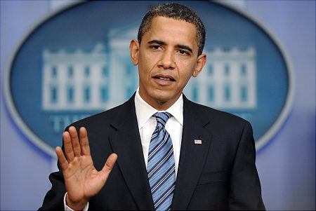
The Executive Branch
United States Government

Slide 2
I. The Executive Branch
Carries out the nation’s laws that Congress passes.
Consist of the president, vice-president, and various executive offices, departments, and agencies.

Slide 3
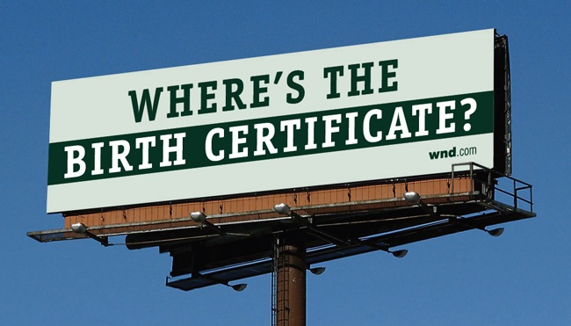
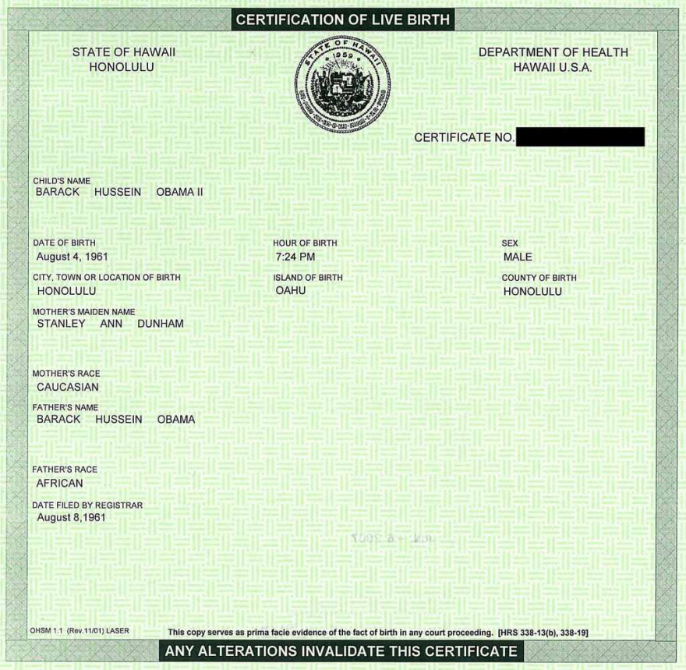
C. Requirements to be President
Natural born citizen
35 years old
Resident of the United States for 14 years

Slide 4
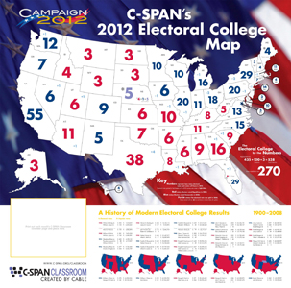
D. Presidential Election
Held every four years
President elected indirectly through the Electoral College

Slide 5
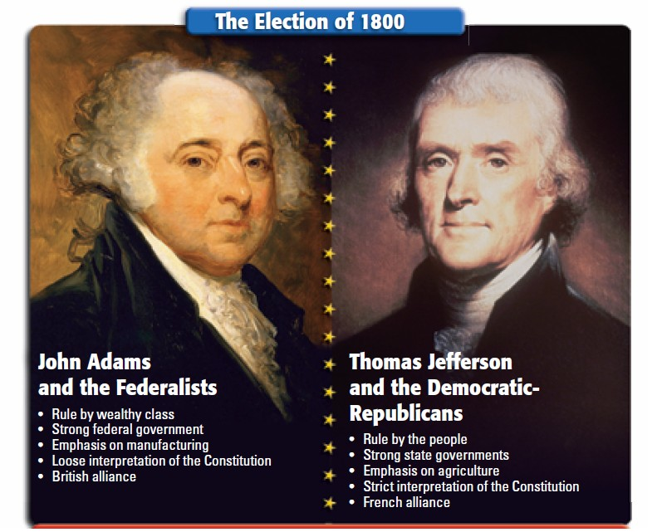
E. Electoral College
At first, the winner became the president and runner-up became the vice-president.
a. This was changed with the 12th Amendment in 1804.

Slide 6
2. Electors now cast separate ballots for the President and Vice-President
3. To be elected, candidate must receive majority of electoral votes. (270 today)
4. If no candidate receives majority, President and Vice-President is chosen by the House of Representatives.

Slide 7
5. Each state gets 1 elector per Senator and House representative. (So each state has at least 3 electors, plus Washington D.C.)
6. Political parties select lists of electors
7. Americans actually choosing Electors from their state when they vote for president and vice-president.
8. Whichever party’s electors get the most votes wins

