Slide 1
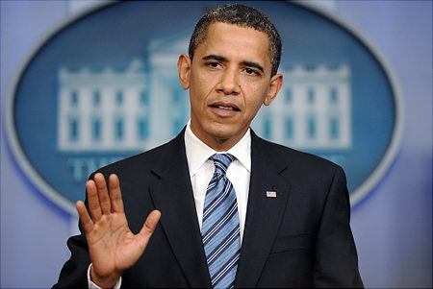
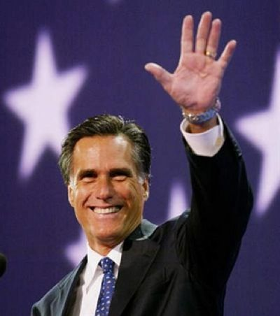
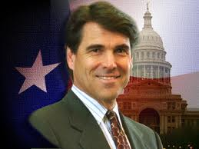
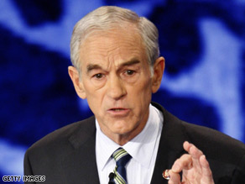
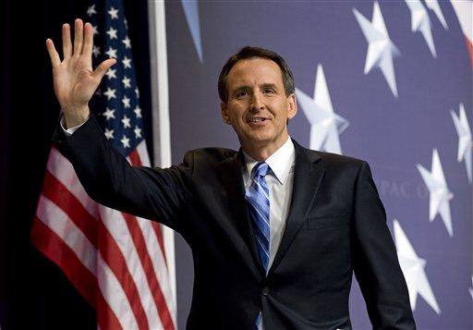
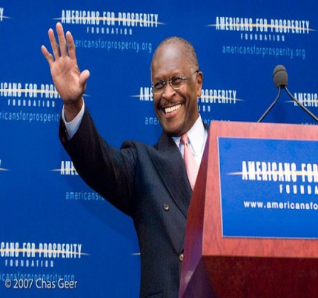
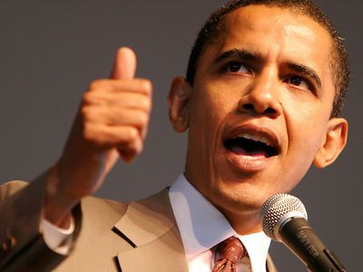
F. Presidential Campaign
1. Primary Elections

Slide 2
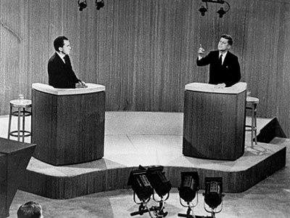
2. Presidential nominee selects running mate.
3. Nationally televised debates
4. Campaigning across the country, with frequent visits to swing states.
5. Election day is in November. (2012)

Slide 3
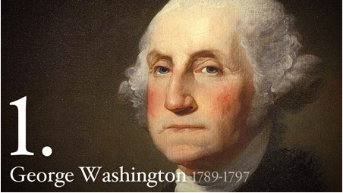
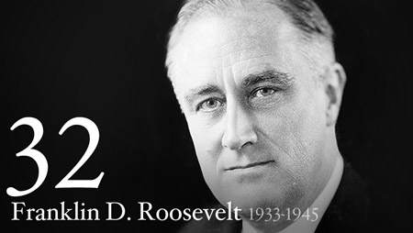
G. Term of Office
President serves a term of 4 years.
22nd Amendment (1951) limits the president to two 4-year terms.
Precedent set by George Washington
Franklin Delano Roosevelt served 3 full terms and died in his fourth, having served 12 years.

Slide 4
H. Powers of the President
Presides over the Executive Branch
Commander and Chief of the nation’s military
Make treaties with other nations
4. Appoints government officials, including Supreme Court justices.
5. Veto laws made by the U.S. Congress
6. Grant pardons to people convicted of federal laws.

Slide 5
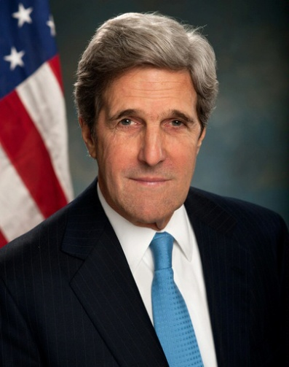
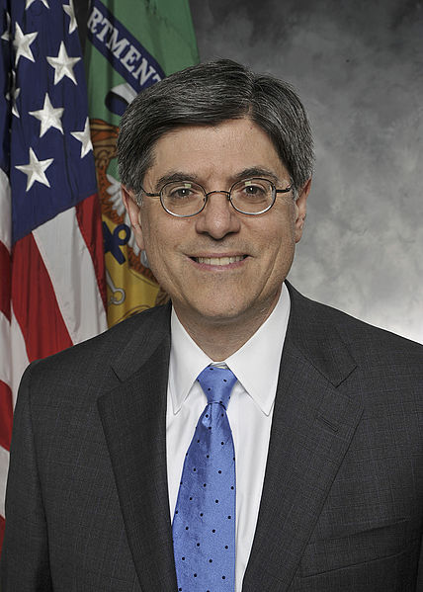
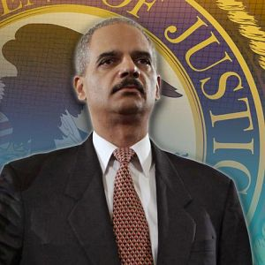
I. The Cabinet
Made up of the executive department heads (secretaries) of 15 governmental departments
Serve as team of advisors to president on important issues.

Slide 6
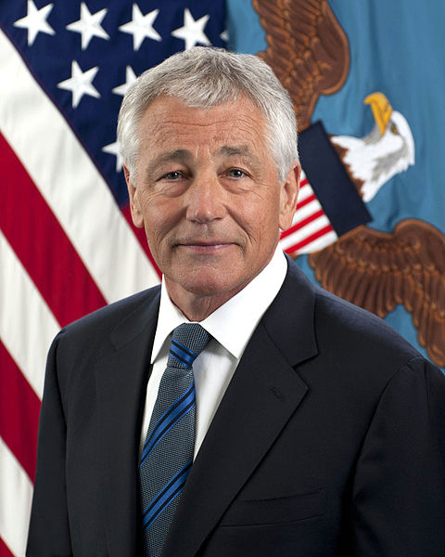
a. Secretary of State – handles relations with foreign countries
b. Secretary of Defense – provides for the nation’s defense. In charge of the military.

Slide 7
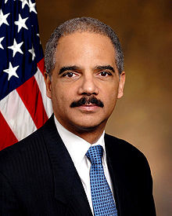
c. Secretary of the Treasury – deals with the countries financial matters
d. Attorney General – handles the government’s legal affairs

Slide 8
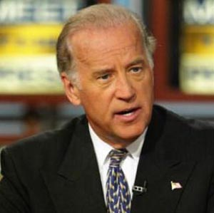
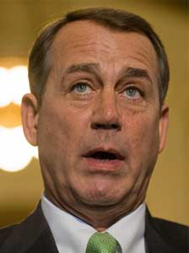
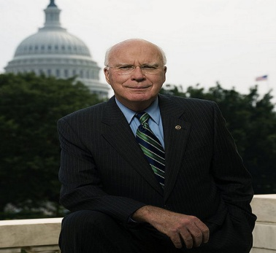
J. Order of Presidential Succession
Vice-President is first to succeed to presidency if the president dies in office
Followed by:
Speaker of the House
President pro-tempore of the Senate.
3. Next, cabinet members are in the line of succession according to the date their offices were established.

